Slide 1

Evaluating TCP vs. UDP in Centralized Multi-Robot Communication using Star Topology Paper ID: 1746
K. Chaitanya Sai, K. Nagendra, and Ravishankar Prakash Desai
Amrita Vishwa Vidyapeetham, Amaravati, Andhra Pradesh, India
Date:22nd August 2025

Slide 2
Table of Contents
Introduction
Literature Survey
Objective
Methodology
Simulation Flow
Simulation Results
Conclusion
References

Slide 3
Introduction
Multi-Robot Systems (MRS) enable teamwork and coordination between autonomous robots.
Widely applied in automation, rescue operations, surveillance, and warehouse logistics.
A centralized star topology simplifies control, since the hub manages all robot communications.
However, this structure introduces a single point of failure at the hub.
Transmission Control Protocol (TCP): reliable communication with acknowledgements and retransmissions, but slower due to overhead.
User Datagram Protocol (UDP): faster and lightweight, but less reliable because of possible packet loss.
Aim of the study: To evaluate which protocol is more suitable for different robotic communication tasks.

Slide 4
Literature Survey
Past studies have used platforms such as ROS, NS-2, and IoT-based setups, but these are not lightweight or MATLAB-based.
Many works did not consider realistic network challenges such as packet loss, delay, and congestion.
AI-based swarm control approaches have been proposed, but they require high computational resources and have not been validated in real-world conditions.
Identified Gap: There is a need for a simple and customizable simulation framework that can evaluate communication protocols under identical conditions while incorporating realistic network faults.

Slide 5
Objective
Compare TCP vs UDP in a centralized six-robot star network.
Create a MATLAB simulation to test both protocols.
Evaluate using:
Latency (speed)
Packet Delivery Ratio (PDR) (reliability)
Retransmissions (overhead)
Throughput (data flow)
Test five real-world inspired communication scenarios.

Slide 6
Methodology
Robots are arranged in a star topology with a central hub.
MATLAB-based simulation models TCP and UDP communication.
TCP: Reliable with acknowledgements and retransmissions.
UDP: Lightweight and faster, but less reliable.
Faults included: packet loss, delay, and jitter.
Five communication scenarios tested: one-to-one, broadcast, many-to-one, sequential, and many-to-many.

Slide 7
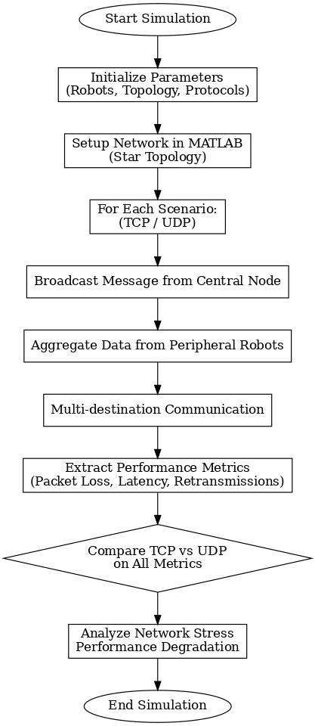
Simulation Flow
A sender robot generates a message for a target robot.
The central hub receives the message and forwards it to the destination.
TCP: Uses acknowledgements and retransmissions to ensure delivery.
UDP: Sends messages without feedback, faster but less reliable.
Network faults are simulated with packet loss (Bernoulli) and delay/jitter (Gaussian).
Performance metrics recorded: latency, throughput, packet delivery ratio (PDR), and retransmissions.

Slide 8
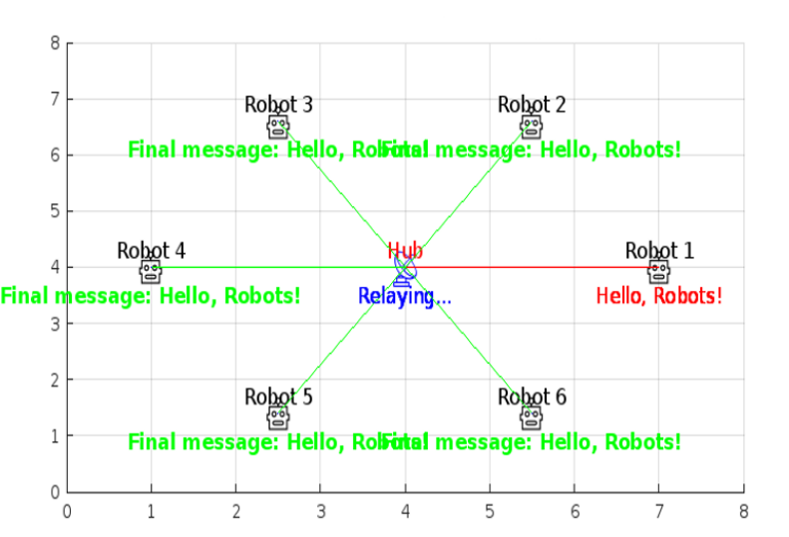
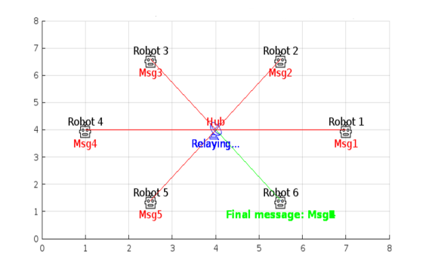
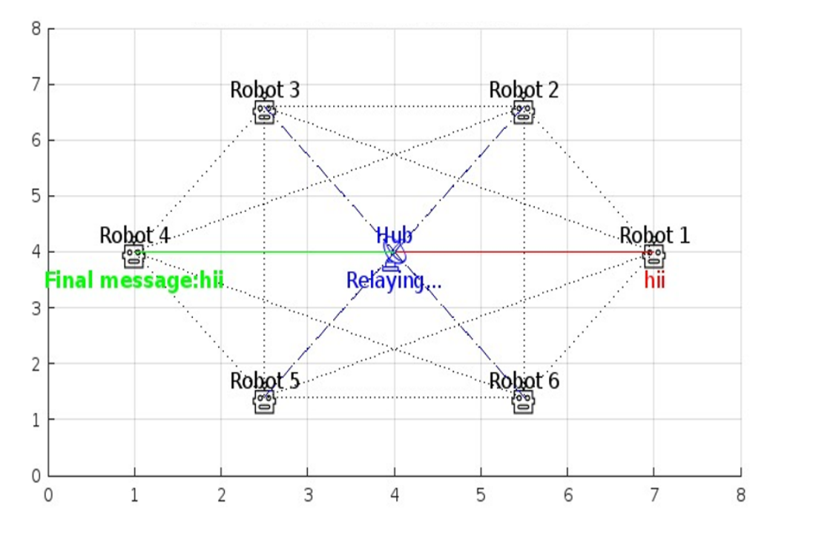
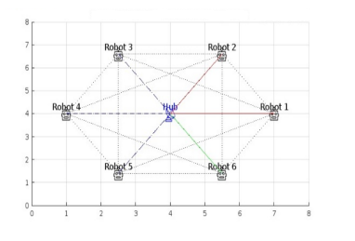
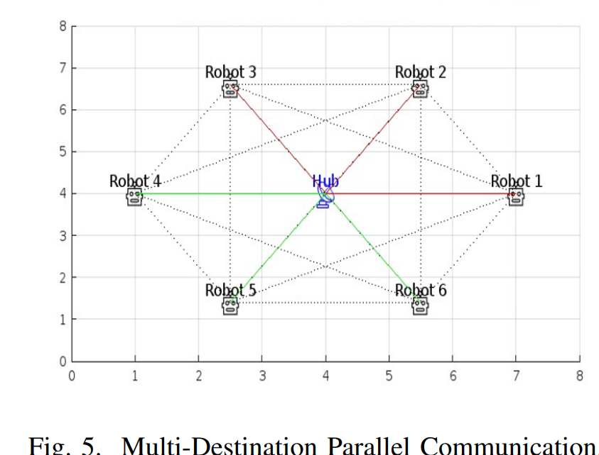
Scenario : 2
Scenario : 3
Scenario : 1
In the Simulation Outputs, blue lines represent the network topology, red lines represent data sent, and green lines represent data received.
Scenario : 4
Scenario : 5

Slide 9
Simulation Results
Scenario | Description | Latency(s) | PDR(%) | Retransmissions
1 | Robot-to-Robot | 0.20 | 100 | 0
2 | One-to-All Broadcast | 0.28 | 96.67 | 3
3 | Multi-Source to Single | 0.33 | 93.33 | 4
4 | Sequential Few Sources | 0.22 | 100 | 0
5 | Multi-Destination Parallel | 0.35 | 91.67 | 5

Slide 10
Conclusion
Built a flexible MATLAB simulation for testing robot communications.
TCP ensures delivery but increases latency.
UDP is faster but risks missing data.
Both protocols have trade-offs; choice depends on application.
Future work:
Test with moving robots
Add more nodes
Try hybrid switching between TCP & UDP.

Slide 11
References
[1] J. Gielis, A. Shankar, and A. Prorok, “A critical review of communications in multi-robot systems,” Current robotics reports, vol. 3, no. 4, pp. 213–225, 2022.
[2] I. Navarro and F. Mat´ıa, “An introduction to swarm robotics,” International Scholarly Research Notices, vol. 2013, no. 1, p. 608164, 2013.
[3] M. Li, K. Lu, H. Zhu, M. Chen, S. Mao, and B. Prabhakaran, “Robot swarm communication networks: architectures, protocols, and applications,” in 2008 third international conference on communications and networking in China. IEEE, 2008, pp. 162–166.
[4] Z. Xu, S. S. Garimella, and V. Tzoumas, “Communication-and computation-efficient distributed decision-making in multi-robot networks,” arXiv preprint arXiv:2407.10382, 2024.
[5] E. Seraj, R. Paleja, L. Pimentel, K. M. Lee, Z. Wang, D. Martin, M. Sklar, J. Zhang, Z. Kakish, and M. Gombolay, “Heterogeneous policy networks for composite robot team communication and coordination,” IEEE Transactions on Robotics, 2024.

